Slide 1
Slovakia

Slide 2
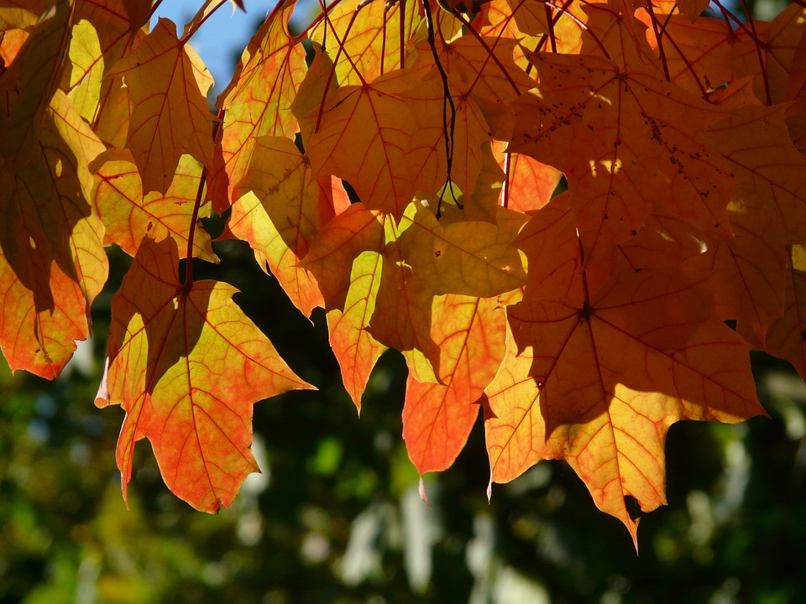
We welcome you to a presentation about us. Let us introduce ourselves.

Slide 3
♣OUR LEADER
Hello friends
Let me introduce myself, my name is Dana Stredakova. I am an English teacher of the Slovak team. I love my students a lot and I am proud of them any time.
I am married, We are a lovely family, me, my husband, our son Alexander and his wife Iris and also cute twins Ivan and Pavel.
In my free time I take care of my flowers, I love reading, travelling, cooking and painting.
I would like to share with you the greatest time and reach excellent project results.

Slide 4
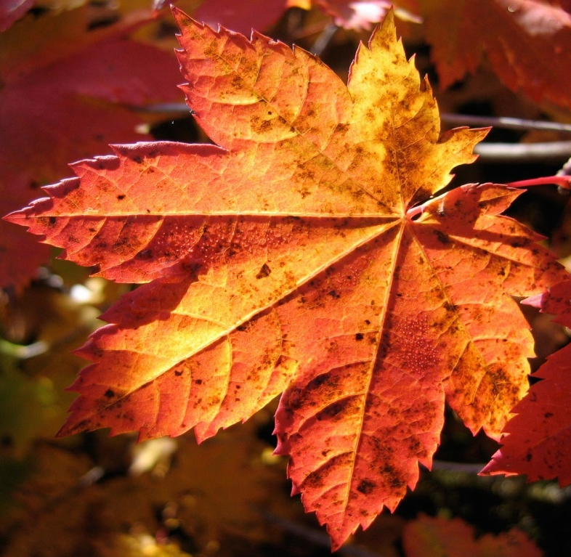
♣Tomáš Kotrbanec
My names is Tomáš Kotrbanec. I am 16 years old. I live in Slovakia in Žilina. I am student of the Hotel Academy .I like footbal,computer game. I am funny,dear. I very much know new people. I really enjoy spending time with friends. My favorite food is spaghetti and the year's favorite season is summer.I have one sister. She is 5 years old. She is very cute.

Slide 5
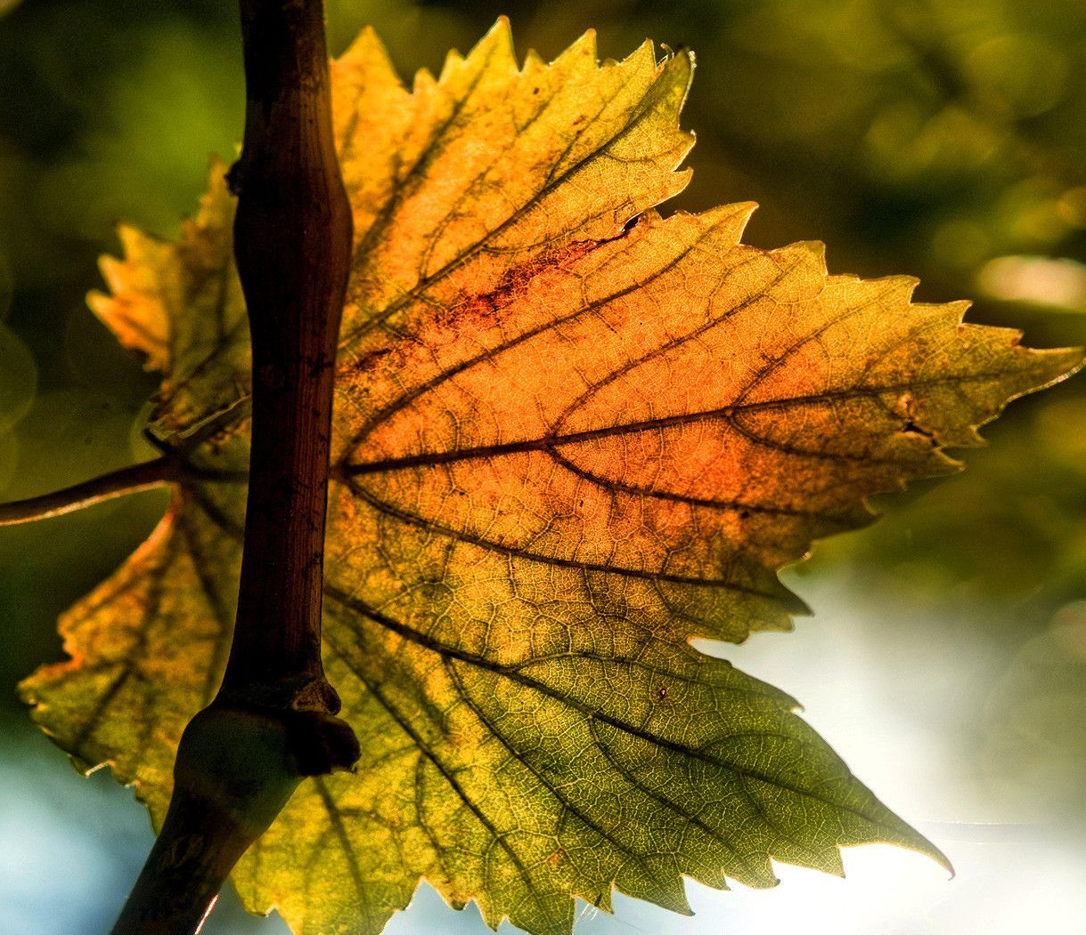
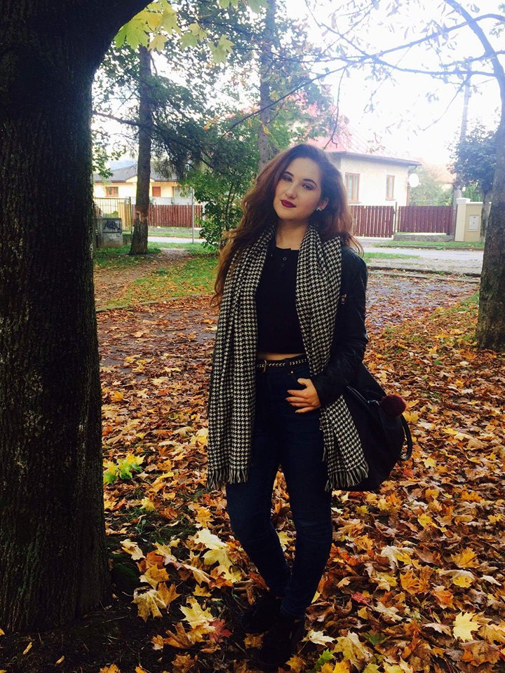
♣Bianka Kováčiková
My name is Bianka. I´m 17 years old. I´m student of a Hotel academy in Žilina. I love reading and spending time with my friends . My hobby is cooking, making DIY decorations and creating interesting make-up looks. My favorite meal is beef with pumpkin sauce and roasted potatoes. I like fall weather the most of all.

Slide 6
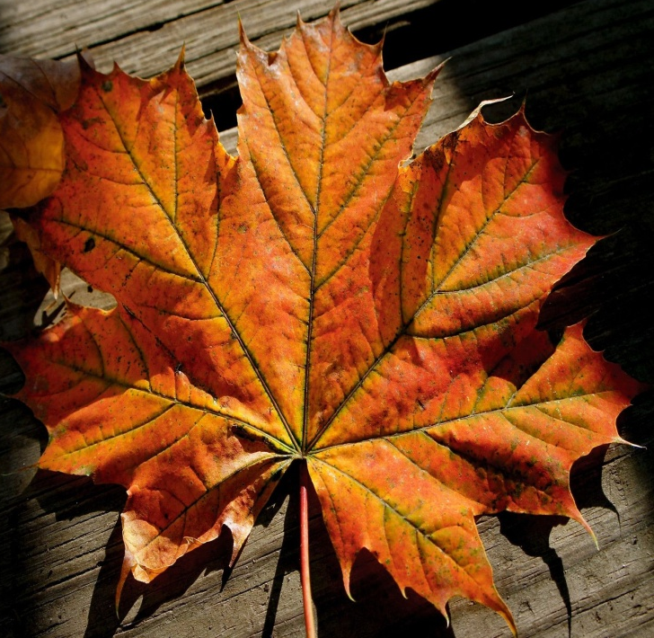
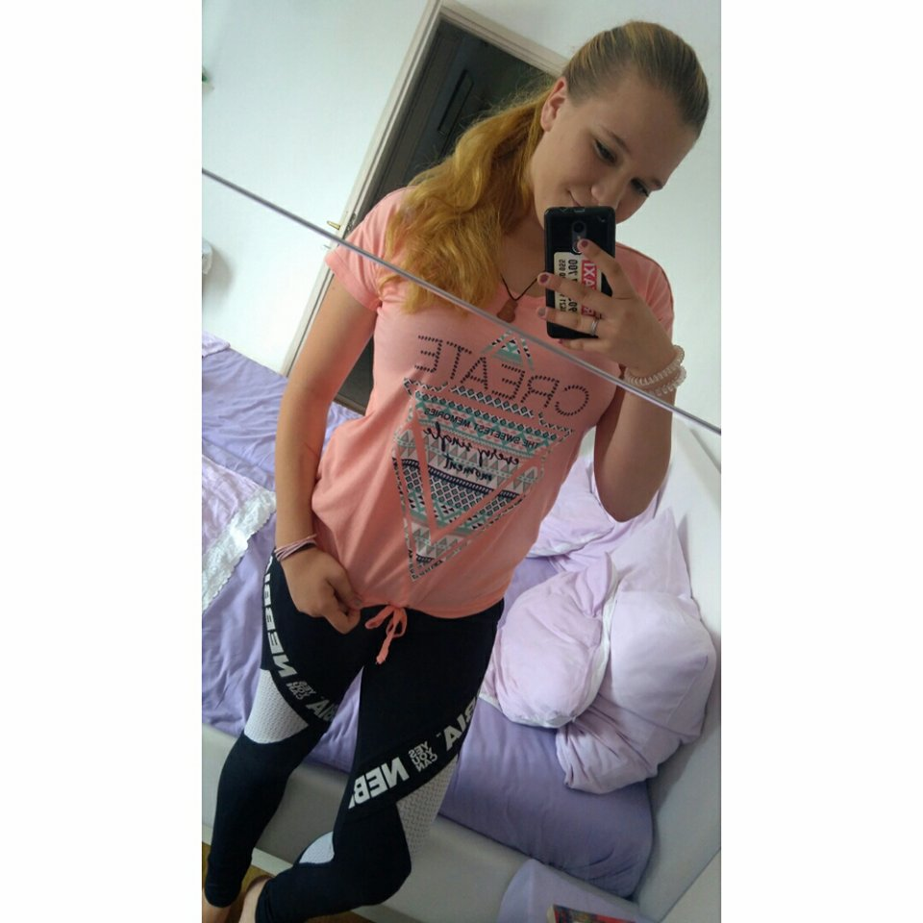
♣Simona Lamlechová
Hello !
My name is Simona Lamlechová. I am 16 years old. I am from Bytča – Slovakia. I am a student of the Hotel Academy in Žilina. My hobbies are for example running, drawing, cooking and baking. I like walking with my friends and hiking with my family. I am driving on roller skates. I enjoy dancing and football. I love reading books and my favorite writer is Michelle Paverová. I have a pet. It is a cat and is called Monty. I love animals. I have one younger brother. His name is Richard and is 8 years old.

Slide 7
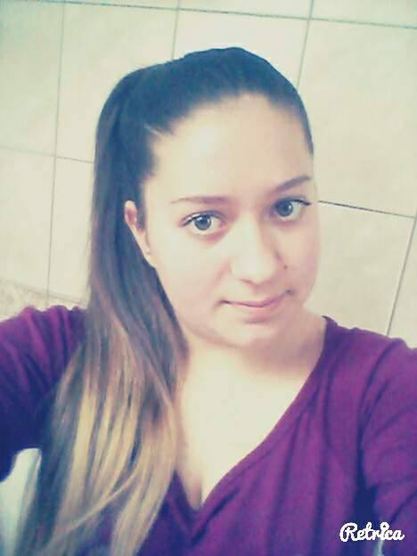
♣Lucia Lukáčiková
Hello!My name is Lucia Lukáčiková. I am 16 years old. I am from Bytča,Slovakia. I am a student of the Hotel Academy in Žilina. I am interesting in firesport. I love it so much! I like walking with my dog Kessy. My other interests are:cooking and baking,reading,cycling. I like spending time with my family and best friend Alžbeta.

Slide 8
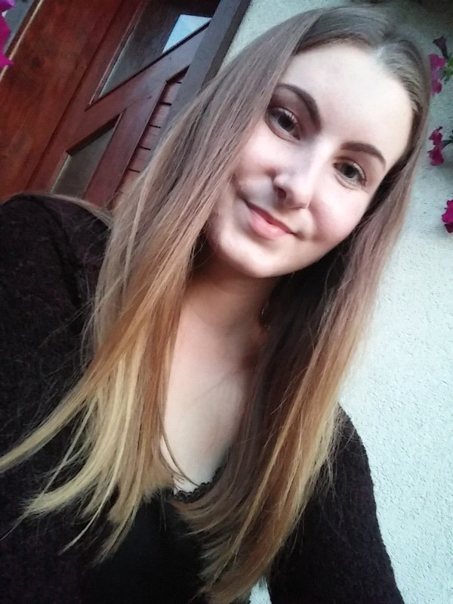
♣Monika Magočová
Hi, my name is Monika Magočová. I´m 17 years old. I live in Žilina and study at the Hotel Academy. I visit 2.F class.
I´m queit, empathic, smiling, sincere and funny. I like meeting new people because we are all diffent. I can help and listen to others.
I love music, fashion, parties, travelling, shopping and reading good books but I prefer my family, friends and boyfriend.
In my leisure time, I like to run, watch soap operas, cook, relax and go outside with my friends.
My motto is... "Your life is what your thoughts make it."

Slide 9
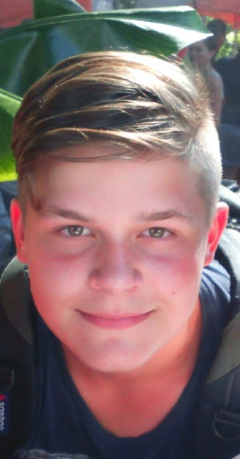
♣Martin Motloch
Hi my name si Martin Motloch. I am 16 years old.I live in Slovakia in the city of Žilina.I am student of the Hotel academy.I dont like autumn and spring.I like playing in accordeon and drumsand sometimes i sang opera.I am optimist,dear,volatile and very funny people,sometimes i have a sense of humor.I like to talk to others than Iam.I have one twin ,she name is Martina.

Slide 10
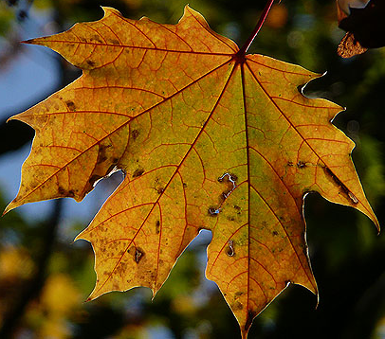
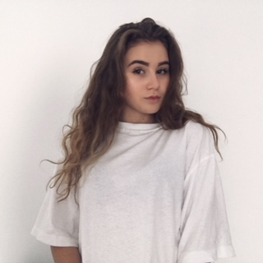
♣Vanessa Obertová
Hello. My name is Vanessa Obertová. I am 16 years old. My birthplace is Slovakia. I am student of Hotel Academy in Žilina. My hobbies is traveling. And since i love traveling , I also need to know the language. English lessons help me to improve my english skills. I love our english lessons because they are not basic as usual.

Slide 11
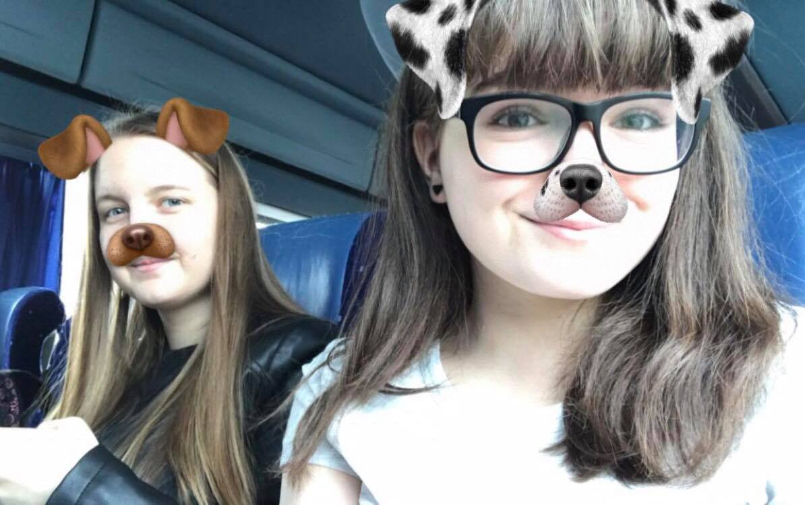
♣Lea Petrželková ♣Patrícia Pechalová
HI!Our names are Patrícia (brown ears) and Lea (white ears). We´re students of the Hotel academy in Žilina. We´re 16 years old. Our hobbies are: English, eating, sleeping, fashion, reading good books, long walks in summer and travelling. We´re interesting working in eTwinning project „Heroes across the borders“.
Our quote: „Be with someone who is good for your mental health.“

Slide 12
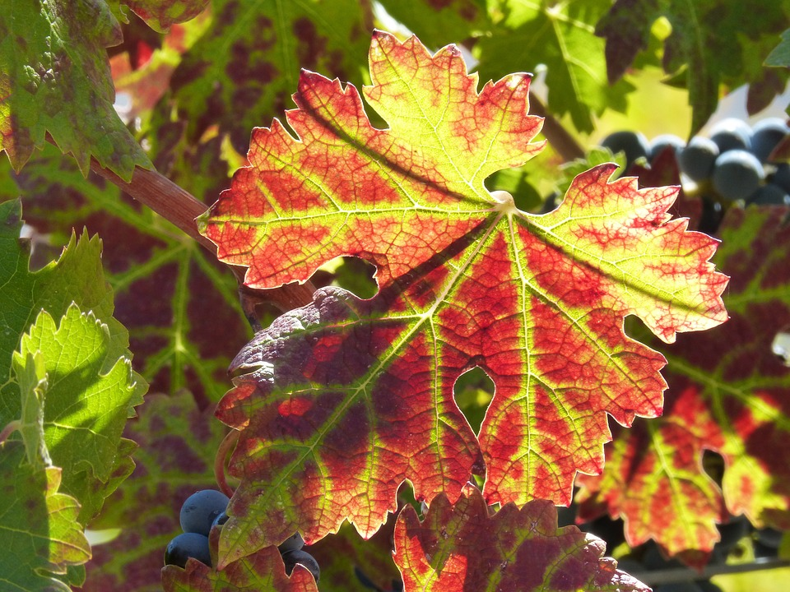
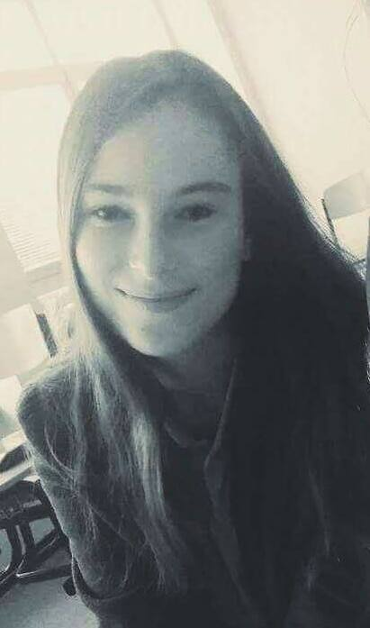
♣ Tímea Prasličáková
Hi,
My name is Tímea but friends call me Mima. I am 17 years old. I am student of a Hotel academy. School is in the Žilina.
My hobbies are cycling, tourism, dog rescue, swimming and snowboarding. I love fun and travel.
In my free time I like to see some serials. My favorite meal is pizza and drink cola. I am an only child. I only have a dog. His name is Pappy.

Slide 13
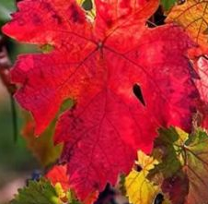
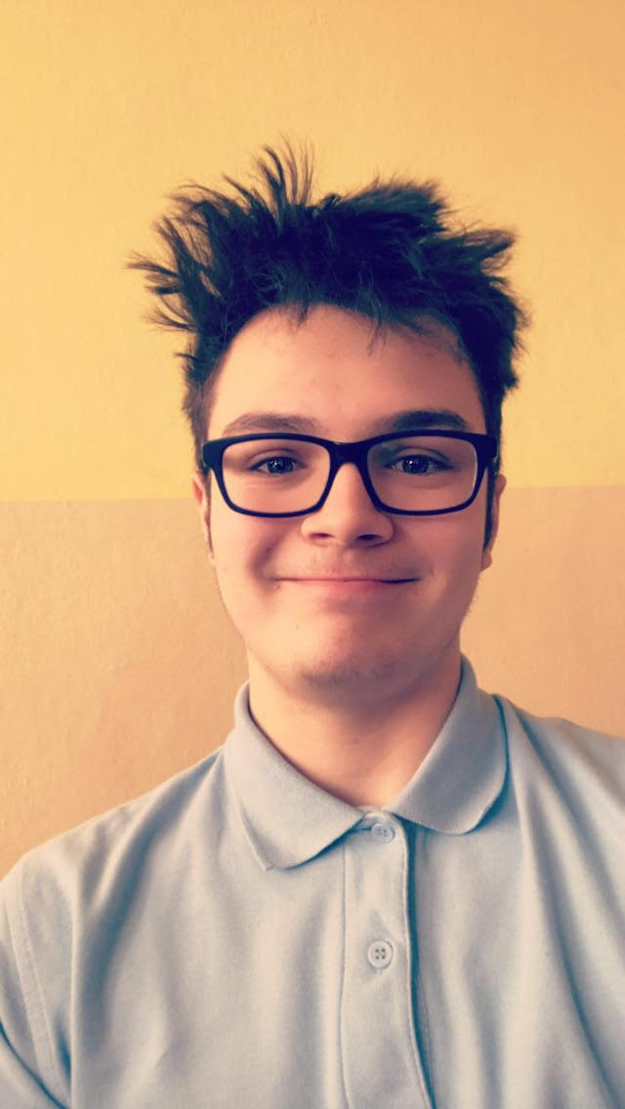
♣ Filip Šedivý
Hello my name is Filip Šedivý. I has been born 23.3.2001 (16yo)
Im student of Hotelová Akadémia Žilina in Slovakia.
My hobbies are playing games (mainly csgo) , travelling with family or with friends and playing football. Im trying to be the best csgo player in Slovakia.
Im really enjoying english lessons because its not boring like everything else in my school.

Slide 14
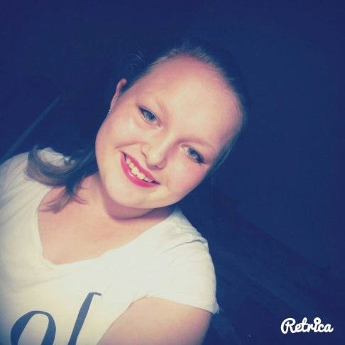
♣Barbora Špircová
My name is Barbora. I am from Slovakia.
I live in Nesluša. I am 16 yaers old.
I am student of the Hotel Academy in Žilina.
My hobbies: playing Mandolína and guitar,
skiing, cycling, roller skating, time spent
with family and friends, skiing, etc.
I love playing Mandolína.
I love skiinkg . I love all seasons.

Slide 15
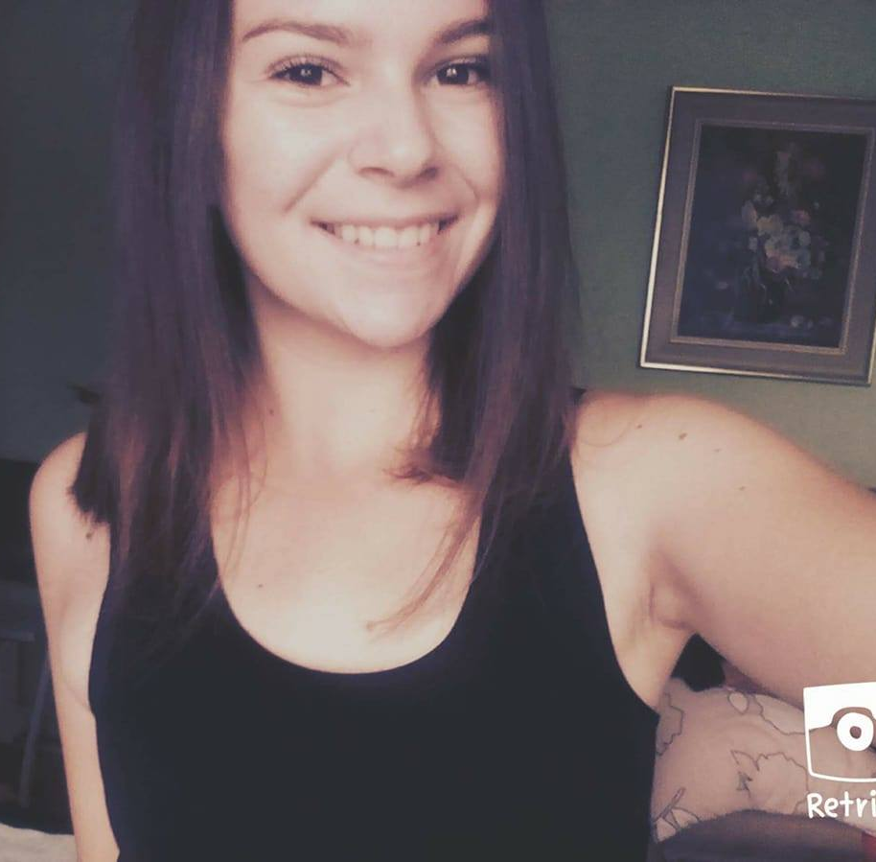
♣Alžbeta Vozáriková
Hi, my name is Alžbeta Vozáriková. I‘m 16 years old and I‘m student of Hotel Academy in Žilina. I live in Bytča, Slovakia. My hobbies involves drawing, sleeping, reading books and I love firesport. I‘m really enjoyed learning English. I have two older brothers. I love spending time with family, my best friend Lucia and with my boyfriend Patrik.My friends tell about me I‘m kind, empathetically and headstrong.
My moto: „Even the smallest person can change the course of the future.“

Slide 16
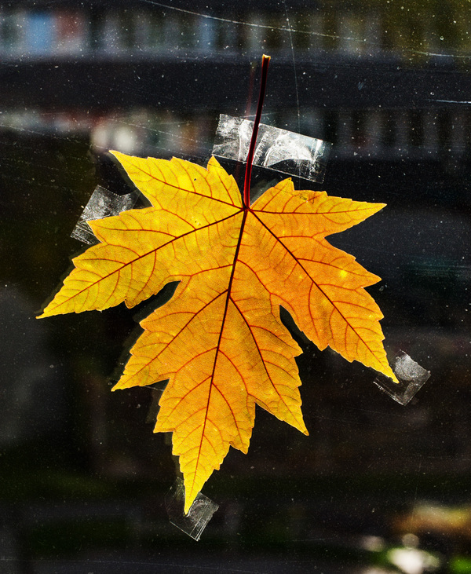
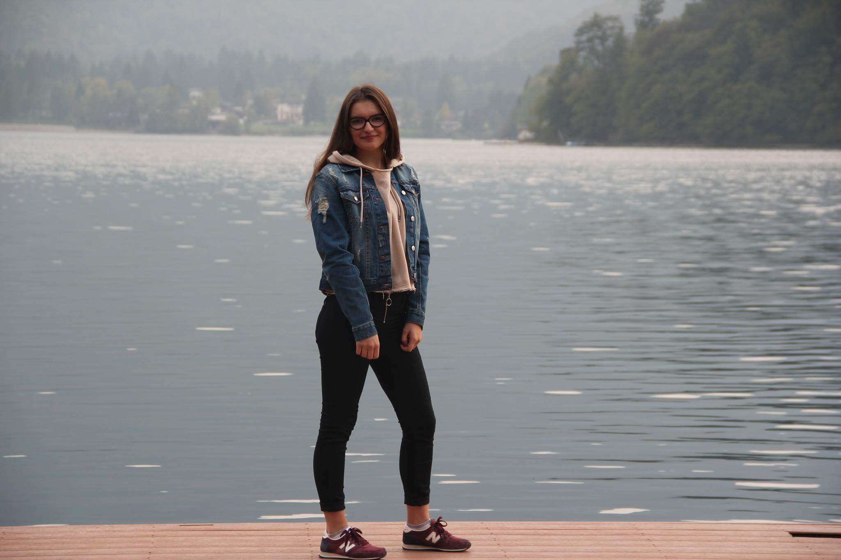
♣Zuzana Žideková
Who am I? My name is Zuzana Žideková and I‘m student of Hotel Academy in Žilina. I‘m 16 years old girl who loves my family, my friends and loves a lot of sports.I actively play volleyball and floorball, but I look at football and hockey on TV or studiums. I am grateful for everything in my life. I live in a small but very nice village on the north of Slovakia.
My moto: „Tomorrow‘s life is too late. Live today.“

Slide 17
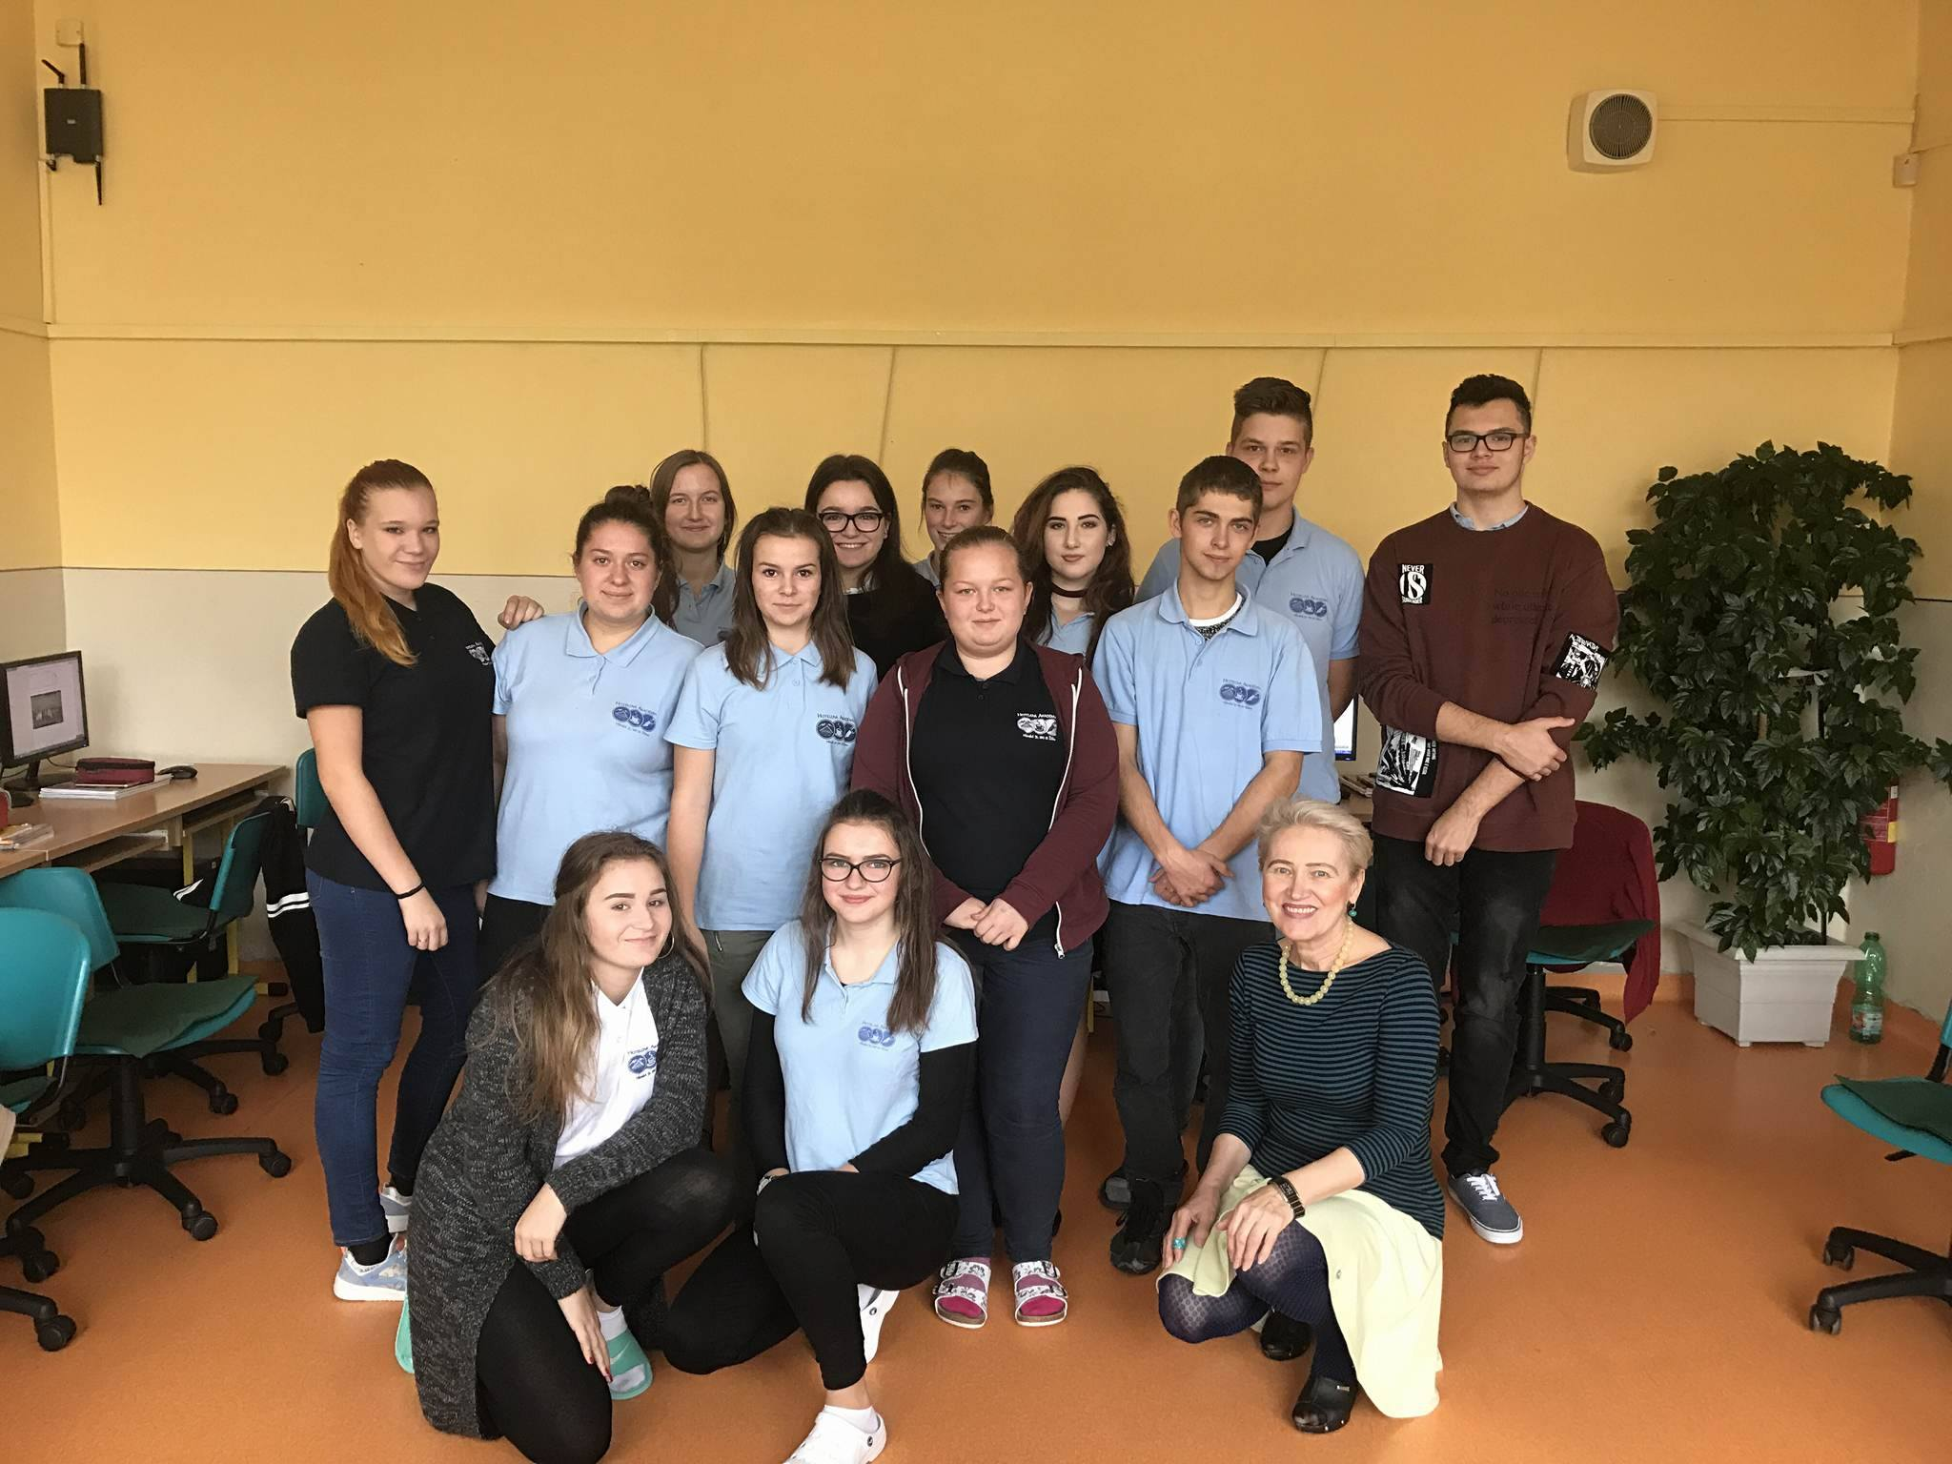
NICE TO MEET YOU!

